Slide 1
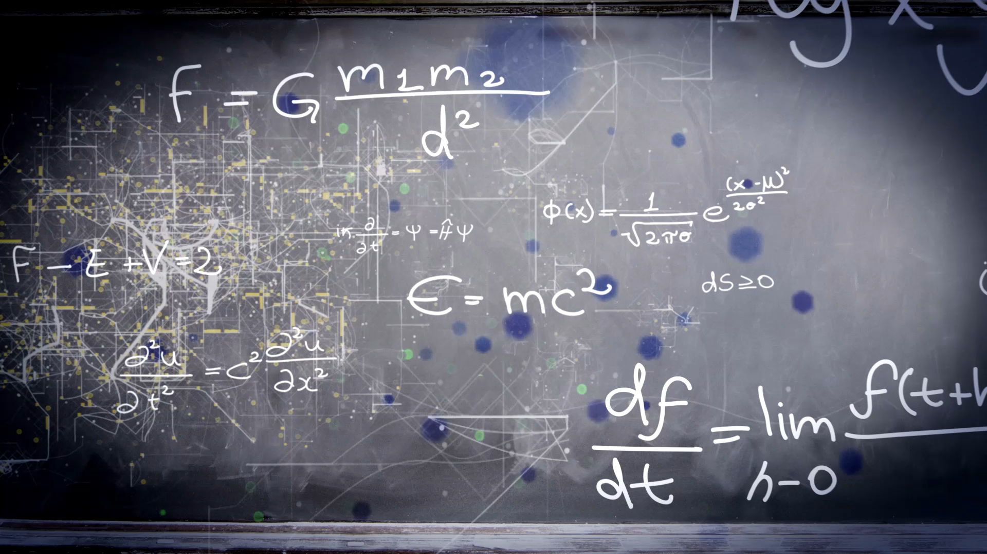
Introduction to Machine Learning

Slide 2




Slide 3

Machine Learning
Using Artificial Intelligence to make predictions in data

Slide 4

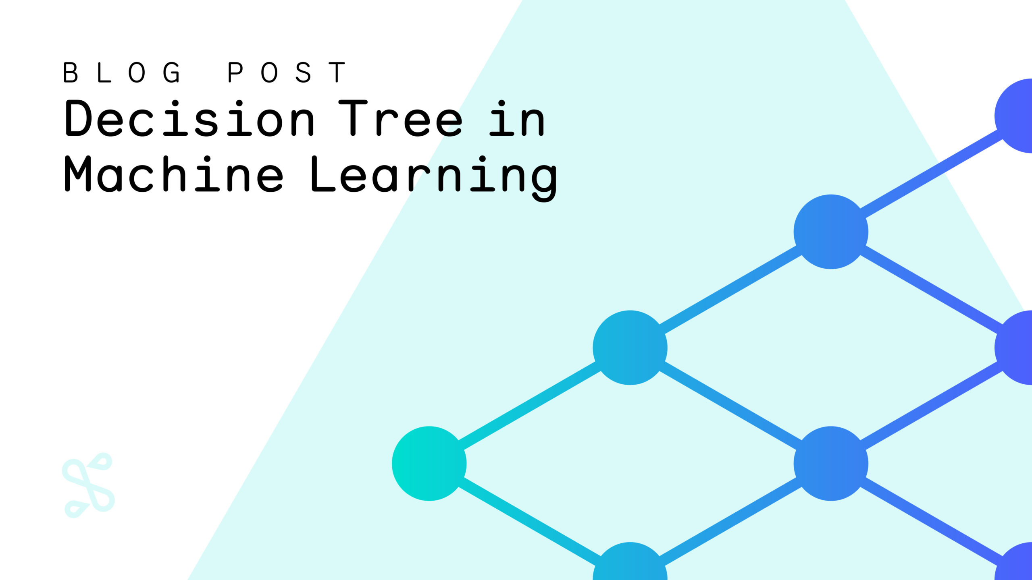

Artificial Intelligence
x = 2
y = 3
If x+y == 5:
print (“This is correct”)
Else:
print(“check calculations”)
Machine Learning
>>> This is correct
Deep Learning

Slide 5



Slide 6
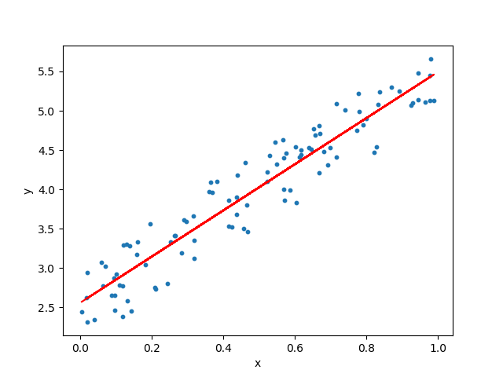
How do you know the algorithm applies to the population?
Notes:
Statistical analyses and Machine learning use regression

Slide 7

Statistical analysis and machine learning
Similarities:
Algorithms
Look to reduce error (e.g., RMSE)
Similar evaluation metrics
Both rely on good quality and quantity of data
Key Differences:
Inference and prediction
ML requires much more data

Slide 8
Machine learning terms
Unsupervised and supervised learning
Training, validation, and testing sets
White box and black box algorithms
Method: R-programming Caret and Python Scikit, Keras, TensorFlow

Slide 9
Unsupervised and supervised learning
Unsupervised & Supervised
Depends on the outcome
Unsupervised (Patterns in data): E.g., K-means clustering & LFA
https://ml-playground.com/
Gender | Location | Purchases a month
Male | Singapore | 5
Female | Malaysia | 7
Female | Singapore | 4
Male | Singapore | 3
Female | Thailand | 9
Example: Clustering – no labels

Slide 10
Unsupervised and supervised learning
Unsupervised & Supervised
Depends on the outcome
Unsupervised (Patterns in data): E.g., K-means clustering & LFA
https://ml-playground.com/
Supervised (Labelled data): E.g., Regression
Gender | Location | Purchases a month | Purchases total
Male | Singapore | 5 | $5000
Female | Malaysia | 7 | $2300
Female | Singapore | 4 | $7000
Male | Singapore | 3 | $8500
Female | Thailand | 9 | $5000
Example: Regression – Purchases as y

Slide 11
White boxes
Clear and Transparent interpretability
Easy to understand
Usually faster
Examples:
Decision trees, SVM, KNN, regression

Slide 12
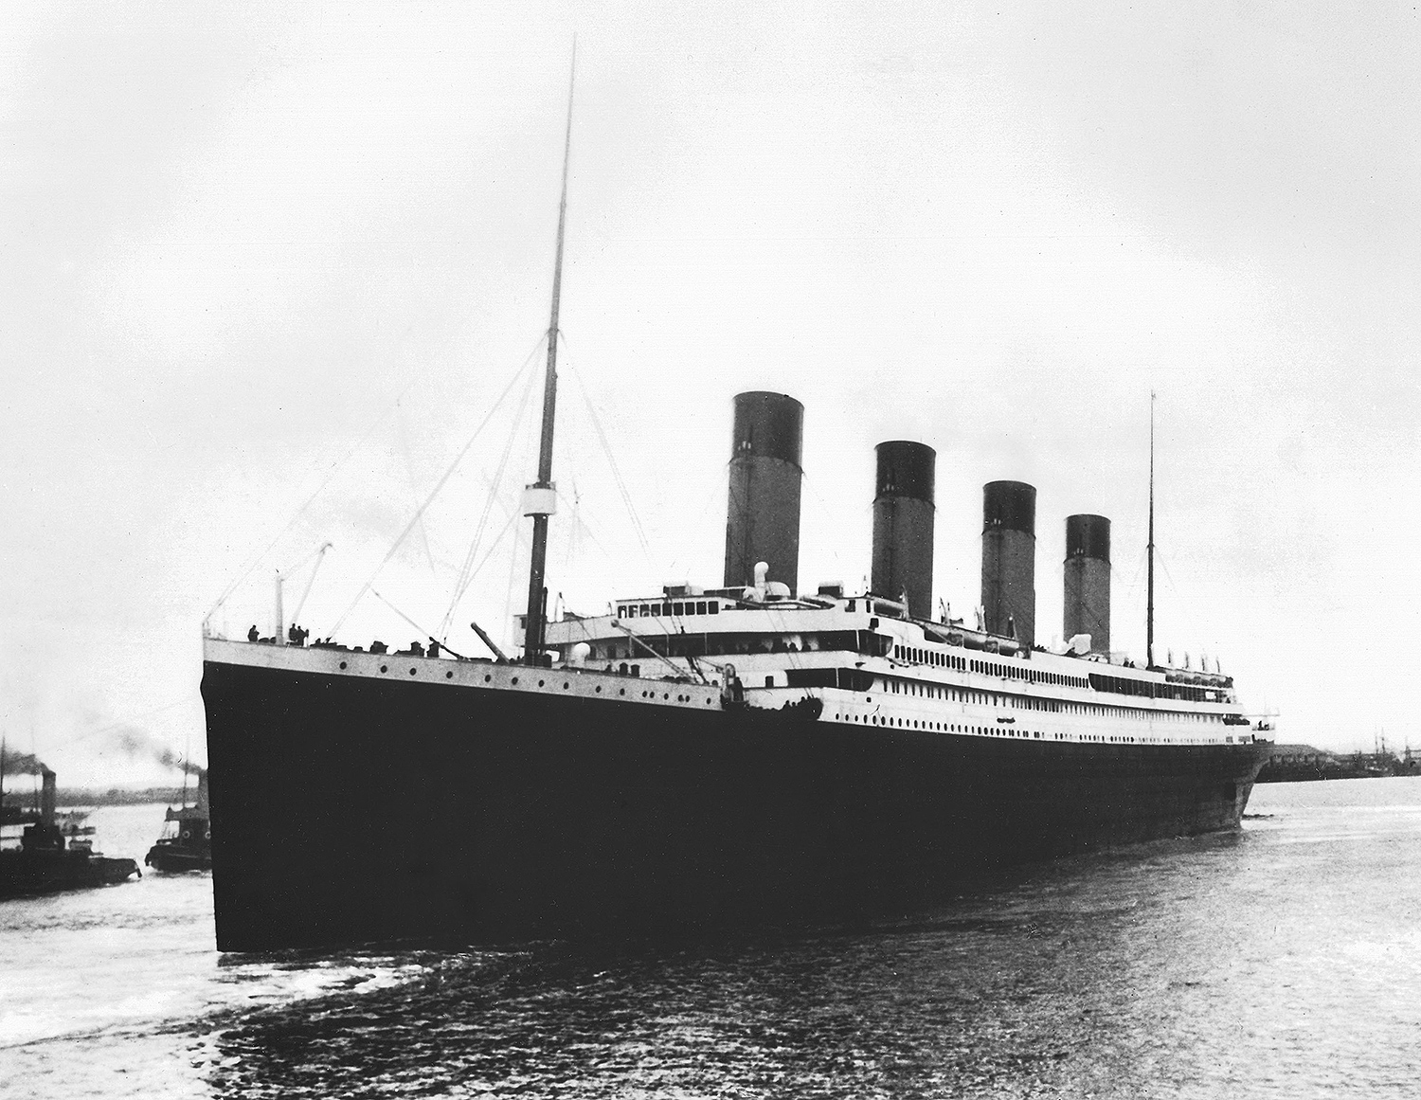

Slide 13
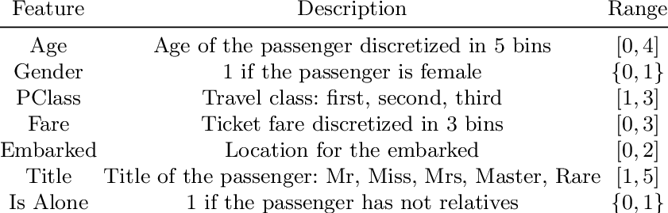
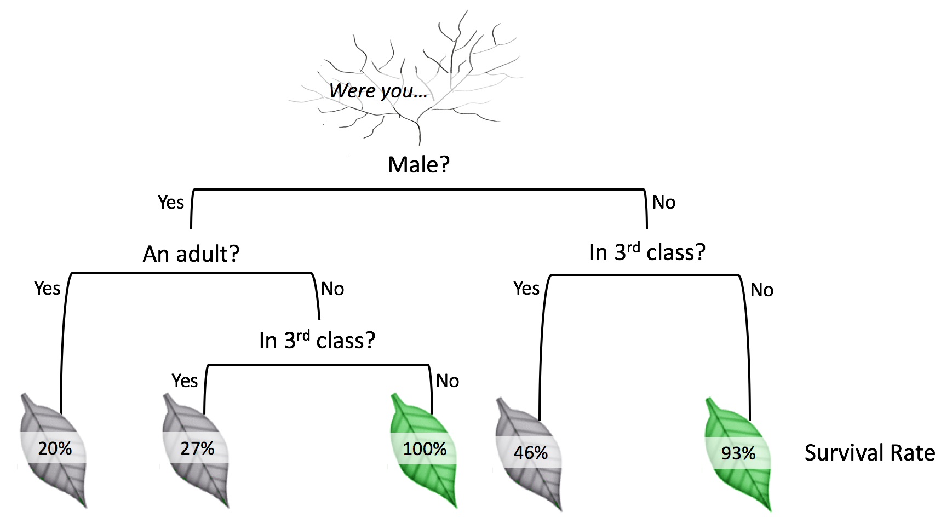
White boxes
Example Classifier: Decision trees

Slide 14

Problem
Lacks predictive complexity

Slide 15
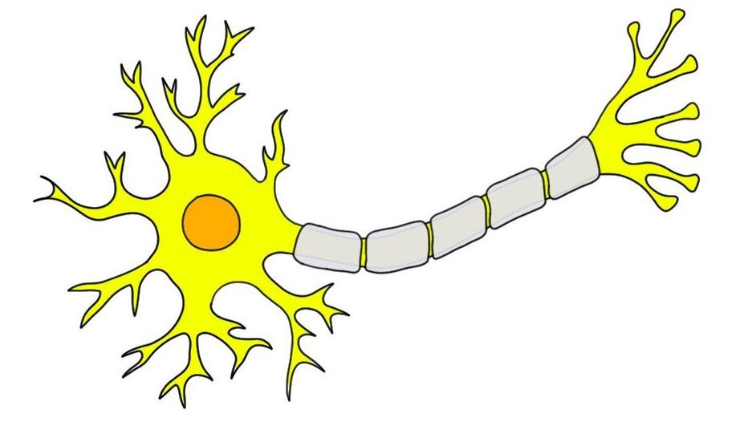

Slide 16
Black Box Algorithms
Example: Neural networks
Perceptron < Multi-layer Network (Deep-layer)

Slide 17
Learning in children

Slide 18
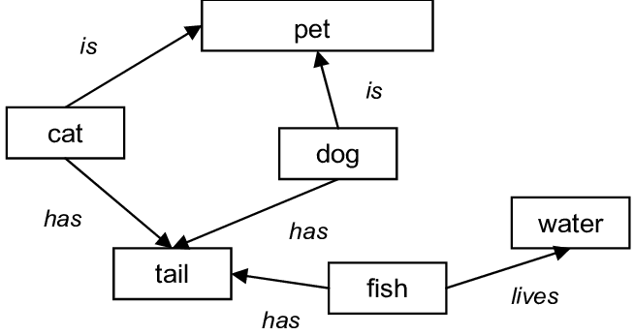
How does the brain learn?
Semantic networks

Slide 19


Slide 20

What is that?

Slide 21
Four legs
learn
Tail
Dog
Fur

Slide 23

What is that?

Slide 24
Four legs
Tail
DOG!
Fur

Slide 25
Four legs
learn
CAT
Tail
Fur
Claws

Slide 27
Black Box Algorithms

Slide 28
Section recap
Machine learning consists of:
Unsupervised and supervised learning
Different types of algorithms
So what makes it different from statistical analysis?

Slide 29
Training, validation, and testing
Training: Applying an algorithm on the data
Validation: Checking if the algorithm applies to a subset of data
Testing: Apply algorithm to data not used in previous steps

Slide 30
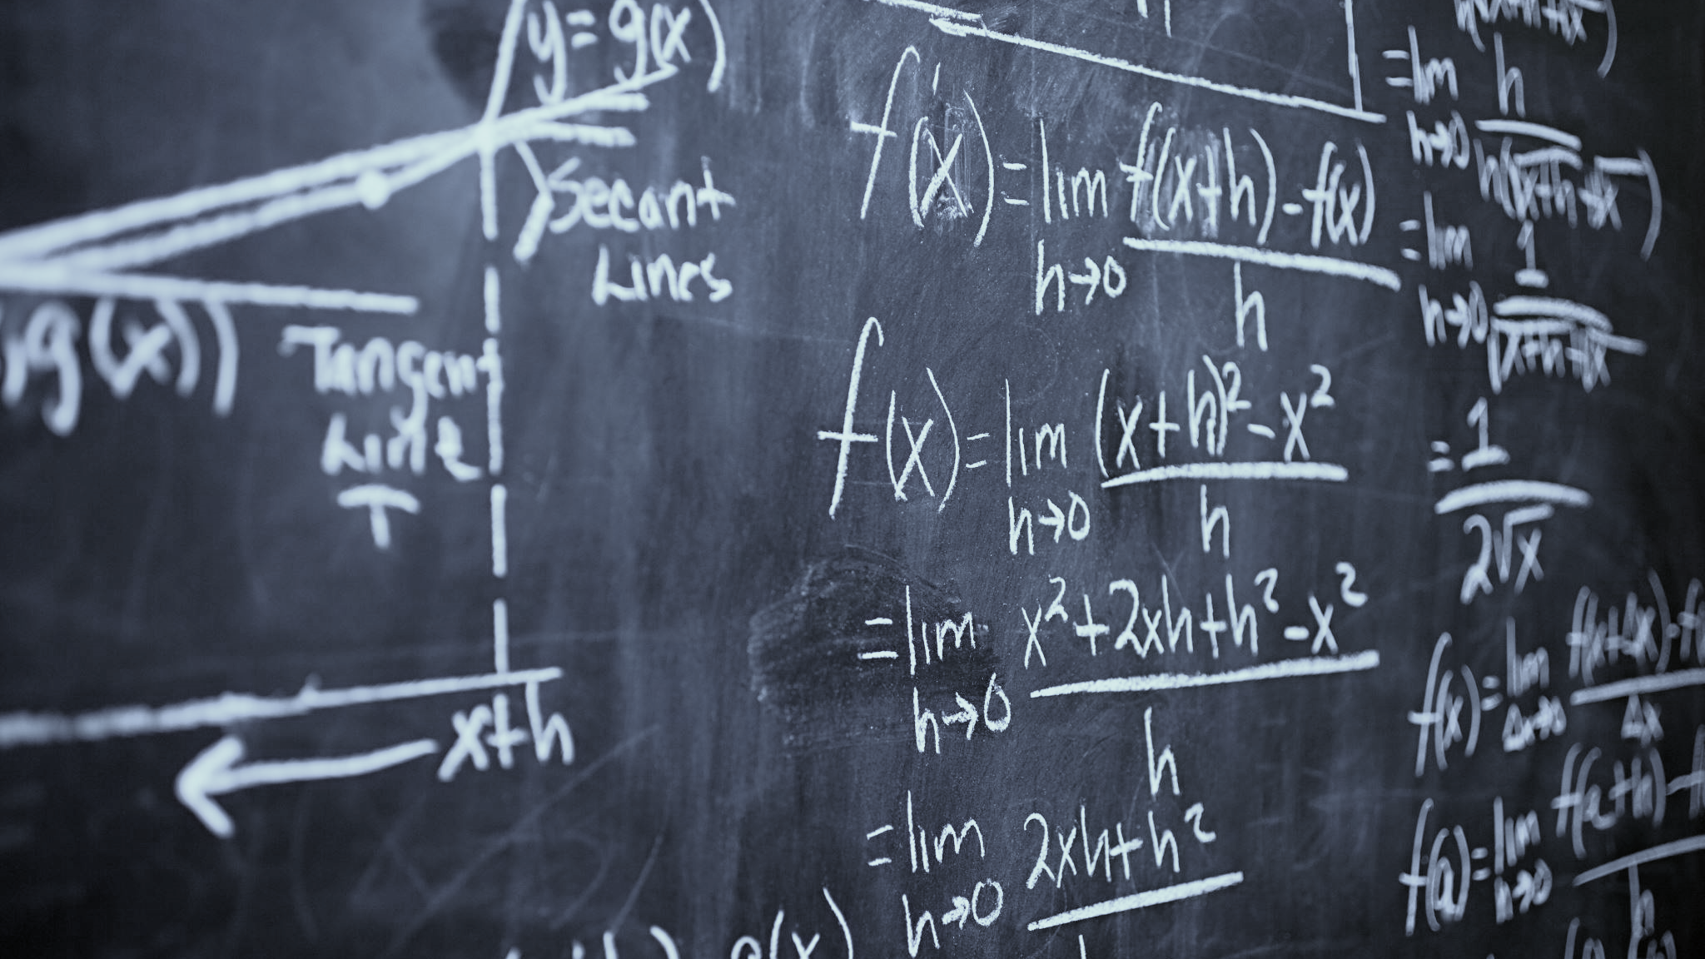
Sitting for a physics exam

Slide 31

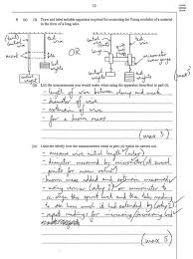


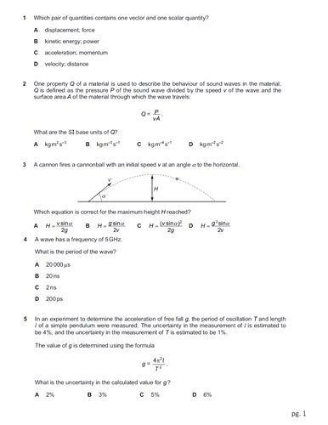


Slide 32
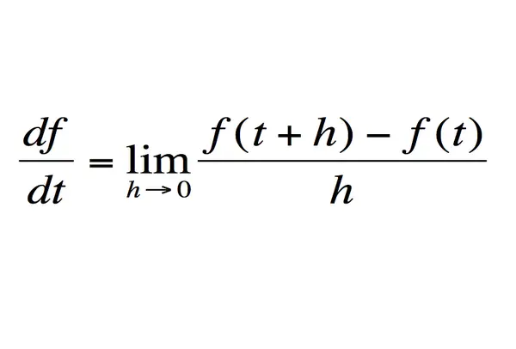
Re-train to reduce error
Re-learn if needed
Input
Training
Validation
Testing

Slide 33

What about statistical inference?

Slide 34
2020 Past year Exam paper
Input
Run algorithm
Testing

Slide 35
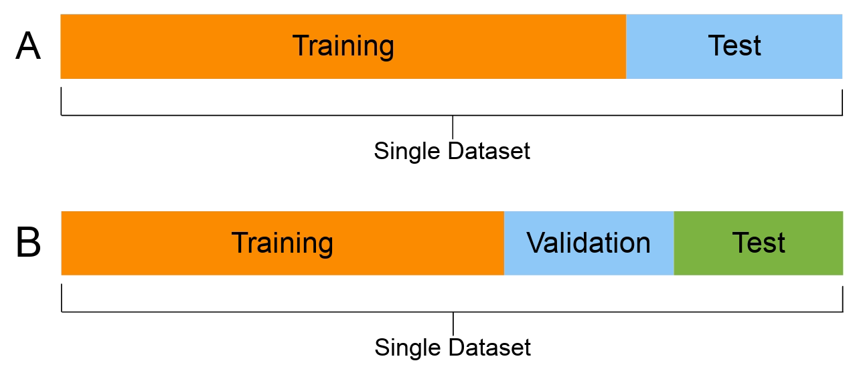
Training, validation, and testing
80:20
Cross-validation
Reducing error in the test set
Over- and under-fitting

Slide 36
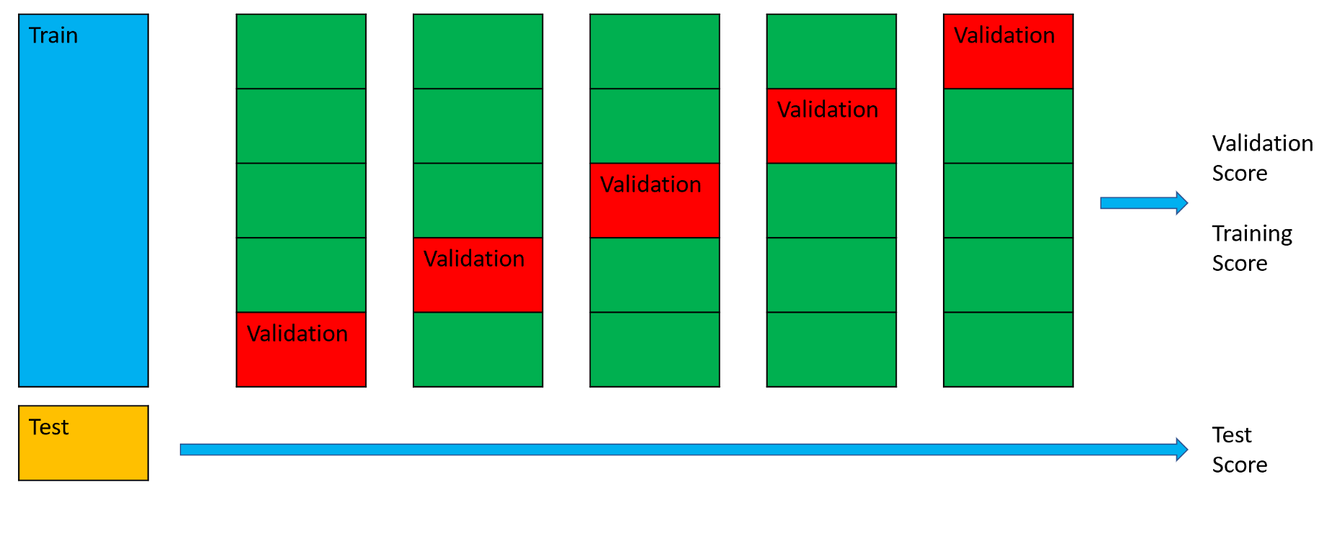

Slide 37
Exam Scores
Engagement

Slide 38
Exam Scores
Engagement
Standard Regression

Slide 39
Exam Scores
Engagement
ML Regression

Slide 40
Exam Scores
Engagement
ML Regression

Slide 41
Exam Scores
Engagement
ML Regression

Slide 42
Exam Scores
Engagement
ML Regression

Slide 43
Exam Scores
ML Regression overfitting
Engagement

Slide 44
Exam Scores
ML Regression overfitting
Engagement

Slide 45
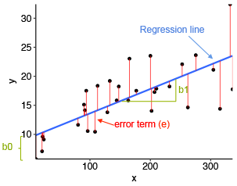
Training, validation, and testing: Regression metrics
Mean Squared Error
Root Mean Squared Error
Mean Absolute Error

Slide 46
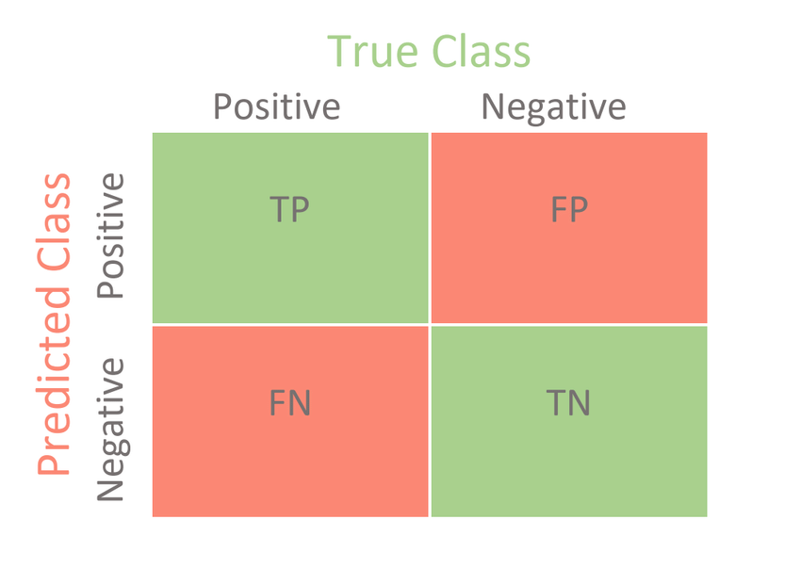
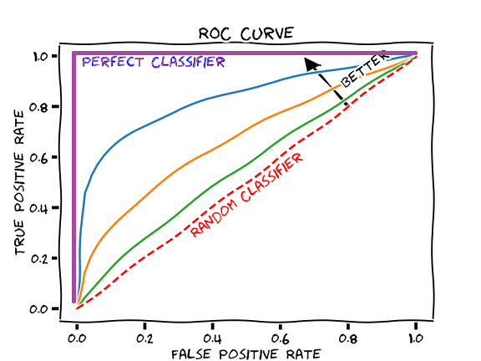
Training, validation, and testing: Classification metrics
Accuracy: Correct predictions / total predictions
Precision: True positives / (true & false positives)
Recall: True positives / (true positives & false negatives)
F1-score: Harmonic mean of Precision and recall
Notes:
ROC: receiver operator curve

Slide 47
Hyperparameters & others
Dependent on the algorithm
Error reduction optimizers:
Gradient Descent & Stochastic Gradient Descent
Stand alone or internal function
RMSE
y = 3 X + C; RMSE: 0.25
y = 3.2 X + C; RMSE: 0.15
…
y = 3.5 X + C; RMSE: 0.1 (best)
y = 4 X + C; RMSE: 0.3
parameter

Slide 48





Methods
caret

Slide 50
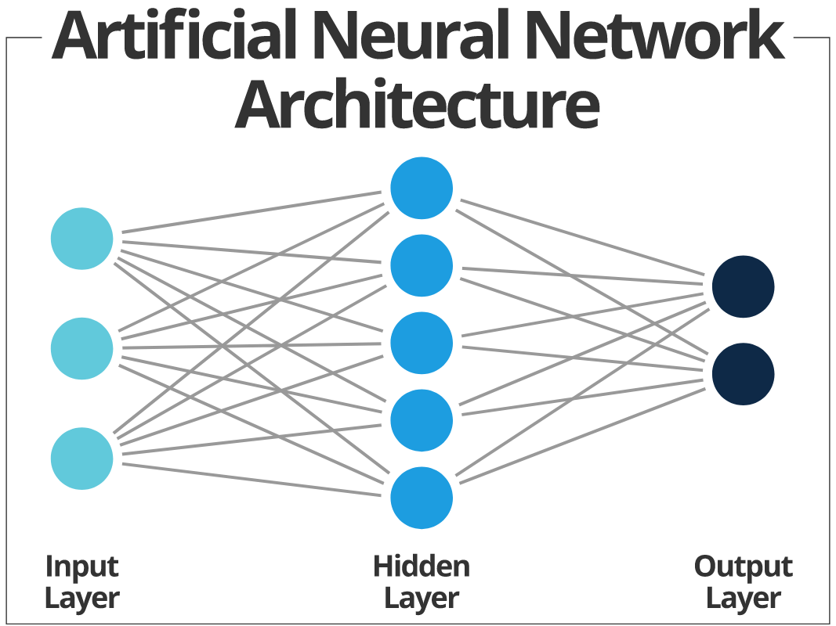

Slide 51
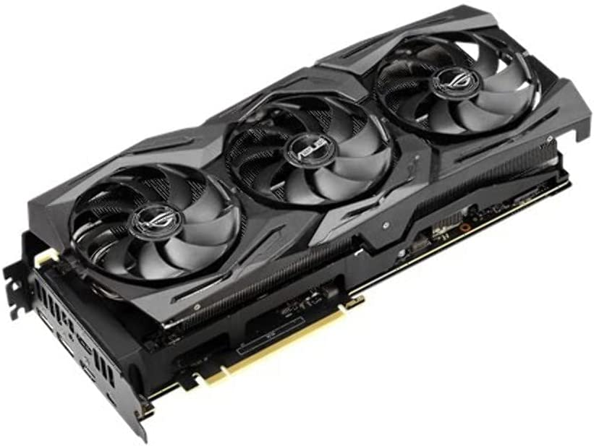
Neural Networks and Tensors
Increased technological performance
Uses data as Matrices (tensors)
Math: Dot Products

Slide 52
Neural Networks and Tensors
Gender | Location | Purchases a month | Purchases total
Male | Singapore | 5 | $5000
Female | Malaysia | 7 | $2300
Female | Singapore | 4 | $7000
Male | Singapore | 3 | $8500
Female | Thailand | 9 | $5000
0 | 0 | 5
1 | 1 | 7
1 | 0 | 4
0 | 0 | 3
1 | 2 | 9
5000
2300
7000
8500
5000
X =
y =

Slide 53
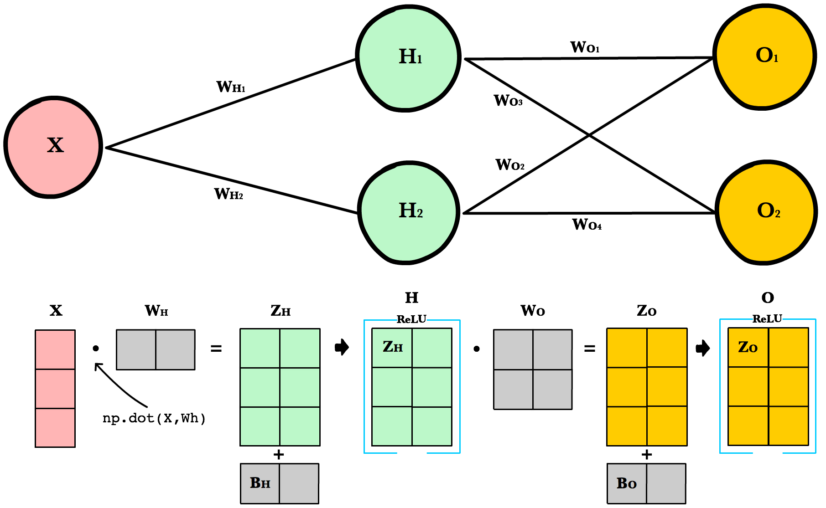
Neural Networks and Tensors
Matrices as tensors
Math: Dot Products
Hidden layers

Slide 54
Neural Networks and Tensors
Gender | Location | Purchases a month | Purchases total
Male | Singapore | 5 | $5000
Female | Malaysia | 7 | $2300
Female | Singapore | 4 | $7000
Male | Singapore | 3 | $8500
Female | Thailand | 9 | $5000
0 | 0 | 5
1 | 1 | 7
1 | 0 | 4
0 | 0 | 3
1 | 2 | 9
5000
2300
7000
8500
5000
X =
y =

Slide 55
This is one epoch (one run)
Bias
Bias
Layer 1 Neuron 1
activation
Weight 3
Weight 1
5500
2100
7200
8400
6000
X
Output: y_pred
Weight 2
Weight 4
Layer 1 Neuron 2
0 | 0 | 5
1 | 1 | 7
1 | 0 | 4
0 | 0 | 3
1 | 2 | 9
activation
X =
Features in red:
Numbers decided by the programme.
Can vary by tweaking hyperparameters such as kernel initializers

Slide 56
y_true
Error
Output: y_pred
5500
2100
7200
8400
6000
5000
2300
7000
8500
5000
500
-200
200
-100
1000
RMSE: 655.74
Run multiple epochs to reduce RMSE

Slide 57
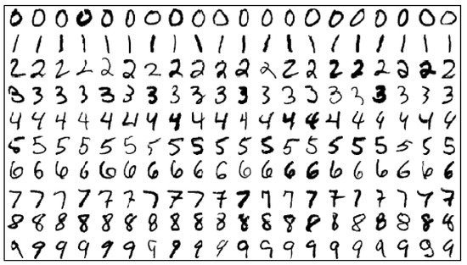
Neural Networks and TensorFlow
Classification and regression
Uses
Image recognition
MNIST
GANs: Image creation (Deep Fakes)
Types of NNs:
Backpropagated NNs, CNNs*, RNNs, LSTMs, Autoencoders
Hyperparameters
Epochs, Activation functions, initializers
*CNN link needs chrome; black box example

Slide 58
This is one epoch (one run)
Bias
Bias
Layer 1 Neuron 1
activation
Weight 3
Weight 1
X
Output: y_pred
y = weight * X + bias
Regression???
Weight 2
Weight 4
Layer 1 Neuron 2
activation

Slide 59
Neural Networks and TensorFlow: What makes it different from regression?

Slide 60

Non-linearity

Slide 61
This is one epoch (one run)
Bias
Bias
Layer 1 Neuron 1
activation
Weight 3
Weight 1
5500
2100
7200
8400
6000
X
Output: y_pred
Weight 2
Weight 4
Layer 1 Neuron 2
activation

Slide 62
Layer 1 Neuron 1
Output: y_pred
activation
Neuron output
Post-activation
-.15
3
1.24
0
-.24
0
3
1.24
0
0

Slide 63
Example: OECD PISA scores
PISA is the OECD's Programme for International Student Assessment. PISA measures 15-year-olds’ ability to use their reading, mathematics and science knowledge and skills to meet real-life challenges.
Similar measures to SKIP UP
~ 10,000 data points
Link: https://www.oecd.org/pisa/publications/pisa-2018-results.htm

Slide 64
Example: OECD PISA scores
RQ: Can measures predict Math ability?
Measures: "Teacher support", "Teacher-directed instruction", "Perceived Feedback", "Parent's emotional support", "Perception of Cooperation at school", "General fear of failure", “Eudaemonia: Meaning in life", "Resilience", "Cognitive Flexibility“
Covariates: Parent Education, Retention, Gender
Outcome: PISA Average Math score

Slide 65
AT THIS POINT: WHY ML?
Prediction
Tech: Faster
Tech: Big - Data

Slide 66
Many Uses
Spam filtering (it started with this)
Recommendation systems (Shopee, Netflix, Amazon)
Finance
Fraud detection
Google Translate

Slide 67


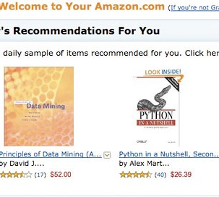
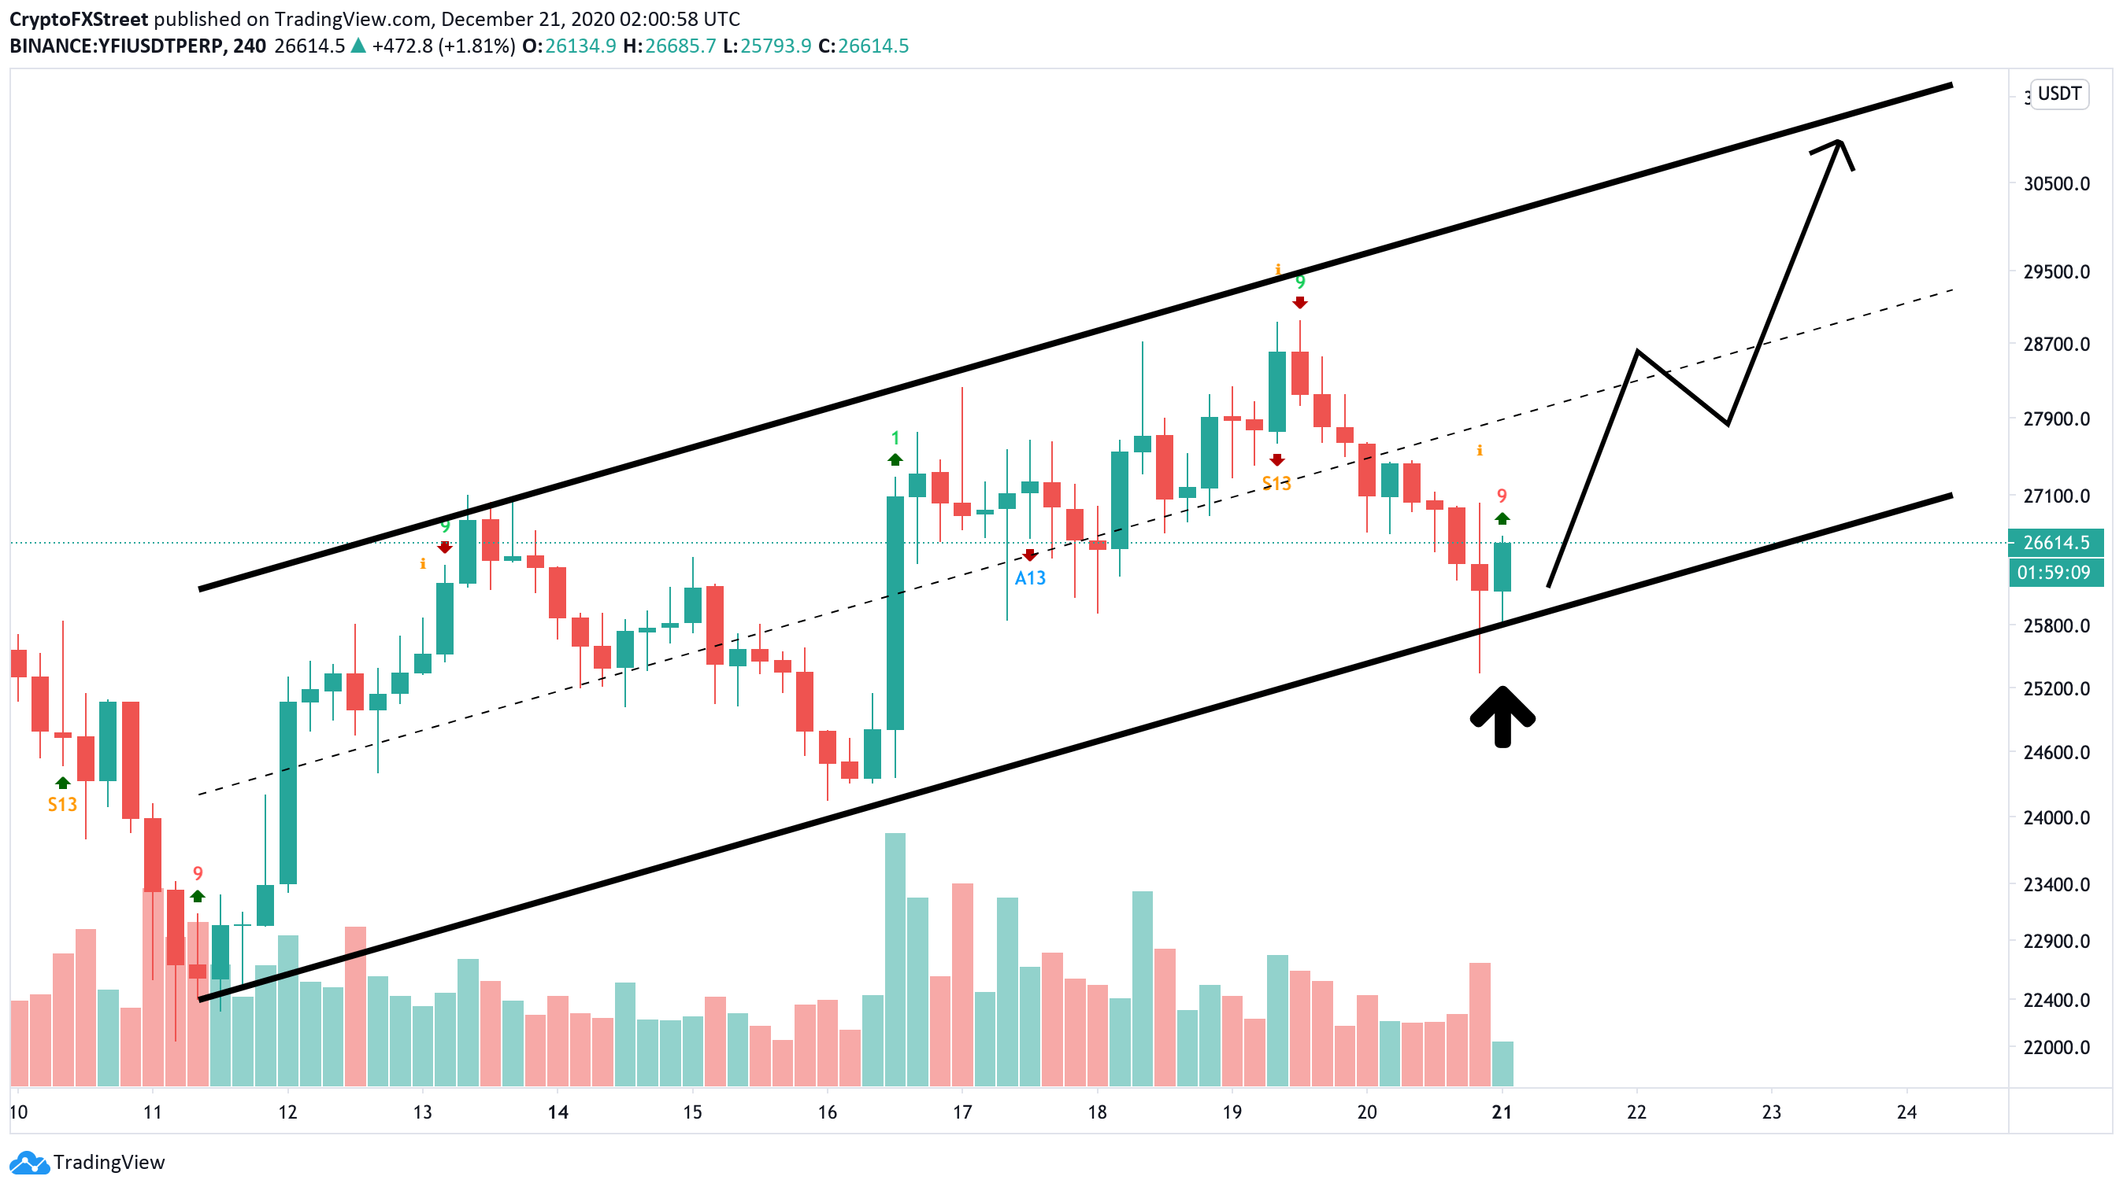

Uses
recommendation systems
fraud detection
spam filters
stock prediction
translations
many many more…

Slide 68
Uses
Algorithm predicts crime a week in advance (June 2022)
The model can predict future crimes one week in advance with about 90% accuracy.
https://www.sciencedaily.com/releases/2022/06/220630114501.htm

Slide 69
Uses
Algorithm predicts crime a week in advance (June 2022)
The model can predict future crimes one week in advance with about 90% accuracy.
but reveals bias in police response
https://www.sciencedaily.com/releases/2022/06/220630114501.htm

Slide 70

Issues

Slide 71
Considerations
“No Free Lunch” principle
Data size
MNIST ~60,000 samples
Missing data
Biased data sources
Ethics

Slide 72

Ethics

Slide 73


Slide 74
Ethical dilemmas
Inference vs Prediction again
Retrospective: “The data suggests…”
Prospective: “Participant has a n% to fail”
Impact of outcome
How to decide if a student is going to drop out of school?
How to tell parents if a child has learning needs?
Type 1 and type 2 errors: False Positives and Negatives
Biases: Racial, gender, socioeconomic status
Influences feature importance
Algorithm design is essentially decided by human input

Slide 75

Recap
Types of supervised and unsupervised learning
What makes ML prediction-focused
Neural networks and complexity
Considerations, biases, and ethics

Slide 76
Resources
https://ml-playground.com/
https://www.oecd.org/pisa/publications/pisa-2018-results.htm
https://www.sciencedaily.com/releases/2022/06/220630114501.htm

Slide 77
To learn DS
https://heicodersacademy.com/
https://www.edx.org/professional-certificate/harvardx-data-science

